Slide 1

Introduction to Deep Learning

Slide 2
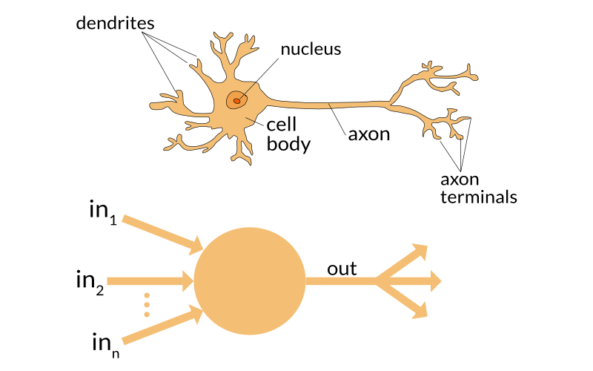
Inspiration
Notes:
Deep learning is inspired from human neuron the way of how they work.
Human neuron receive input from dendrites, processes it and us axon to send the output. Basically, It emulates the way how human learn.

Slide 3

Notes:
Simple Neural Network:
1- input layer, 1 hidden layer and 1 output layer
Deep Learning Neural Network with 1 input layer 4 hidden layers and 1 output layer

Slide 4
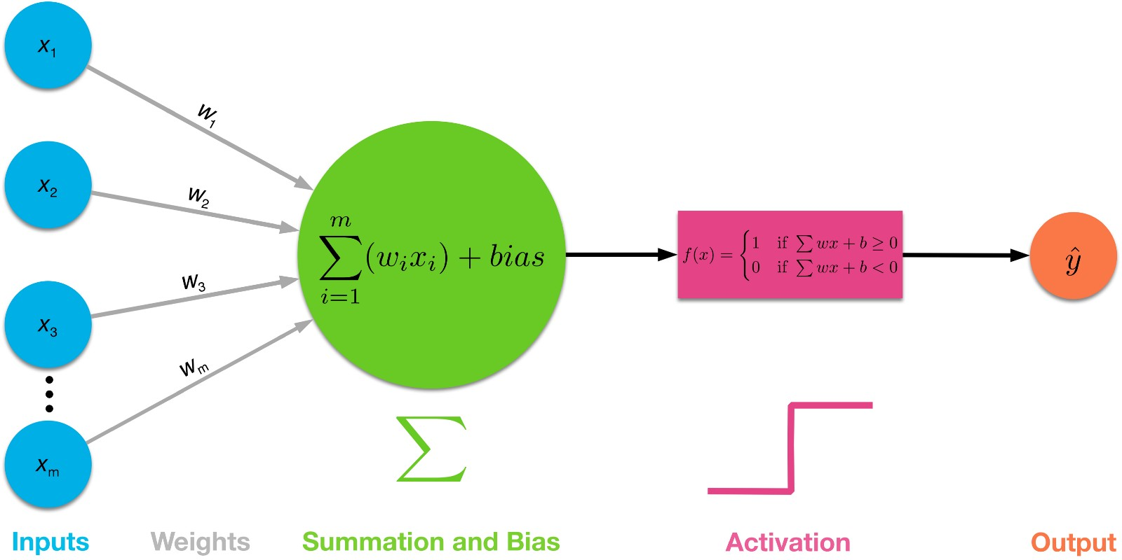
Perceptron
Notes:
The perceptron is the basic model of neural network having only 1 input layer, 1 neuron and 1 output layer.
Activation function -> non-linear activation function, introduce non-linearities. The activation function does the non-linear transformation to the input making it capable to learn and perform more complex tasks
The bias add another dimension to the input space to deal where the input vector are all 0 and somehow is independent from input and output. It is also used to shift the curve.

Slide 5
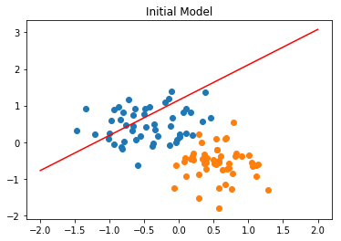
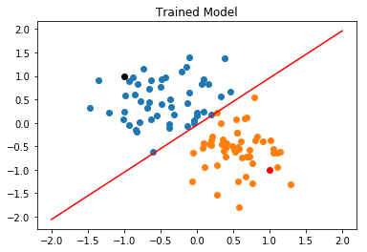

Slide 6

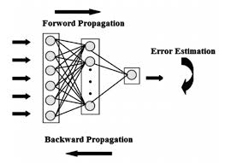
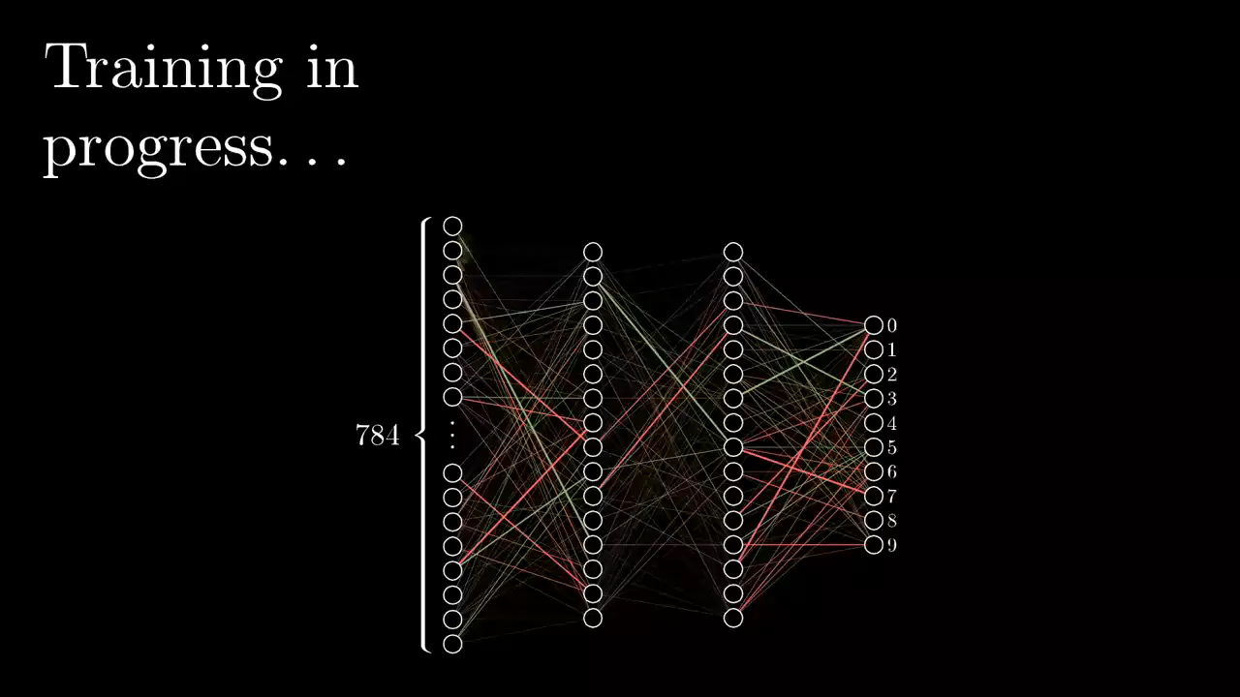
How Neural Network work?
Notes:
Goal of the model: minimize the loss and improve the accuracy.
Is done through back propagation through gradient descent, backtracking through all layers to update the weights and biases of every node.

Slide 7
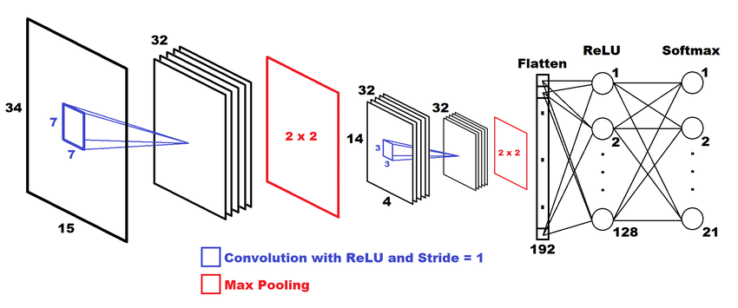
Convolutional Neural Network
Notes:
Conv Layer: feature extraction and data representation. Imagine an image 1000 x 1000. This is done by using filters(kernels).
Pooling layer – dimensionality reduction, dealing with overfitting . Max pooling and average pooling
ReLU – the activation function

Slide 8
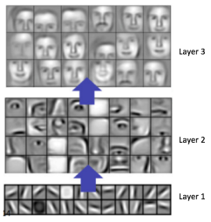
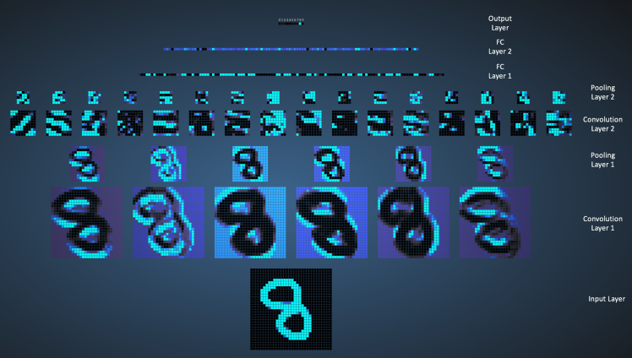

Slide 9
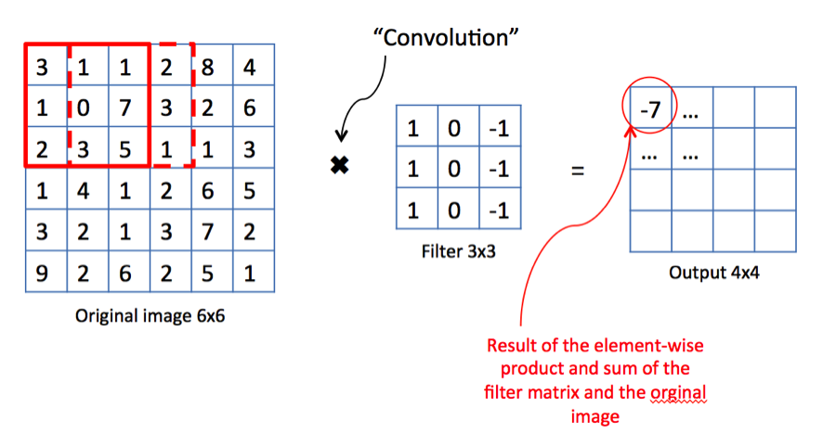

Convolution and pooling layer

Slide 10
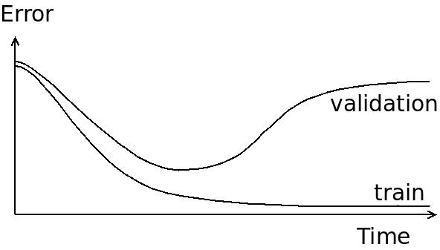
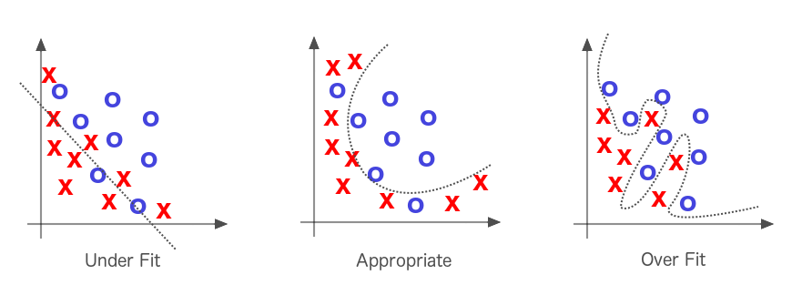
Overfitting and Underfitting

Slide 11
Ali Doku AI Engineer & Data Scientist +32 489 84 28 73 ali.doku@arinti.ai
www.arinti.ai
Veldkant 33a 2550 Kontich
Gaston Geenslaan 11 B4 3000 Heverlee

